Slide 1
Classifying Election Violence with Machine Learning
Sam Cohen

Slide 2

Research Question
What factors predict instances of electoral violence? How can they predict the likelihood of electoral violence occurring?

Slide 3



Background & Motivation
Election violence is a real and growing phenomenon, even in relatively developed and stable countries
Few studies use machine learning to take into account the variables that may play a role in violent elections
Determining the chances & variables that influence election violence may allow institutions & political actors to ensure free, fair, and safe voting practices

Slide 4




Data & Platforms
Election violence data from DECO (Uppsala Conflict Data Program)
Development and Socioeconomic indicators from World Bank
Decision and Random Forest algorithms from SciKitLearn package in Python
Project completed in Jupyter notebook

Slide 5
Process, Model, & Methodology
Preprocessing
Cleaning
Merging
Merging DECO data with WB indicators on country-year level
EDA
Summary statistics, data viz, regressions
ML and tuning
One-hot encoding
Deleting extraneous variables
Target variable: electoral violence uncertainty (0, 1, or 2)
Decision tree and random forest algorithms
Hyperparameter tuning and variable importance
Increase of features: 41 to 183 after preprocessing and merging
Country with most violence: India
Most common purpose: disruption
Majority of violence occurred before elections
Correlation mapping
*
Challenges: small data set (~4,300 observations); categorical variables not well validated; limited continuous variables; dimensionality; overfitting tendencies among models chosen; target variable measures uncertainty, so classification (rather than prediction) easier to establish

Slide 6
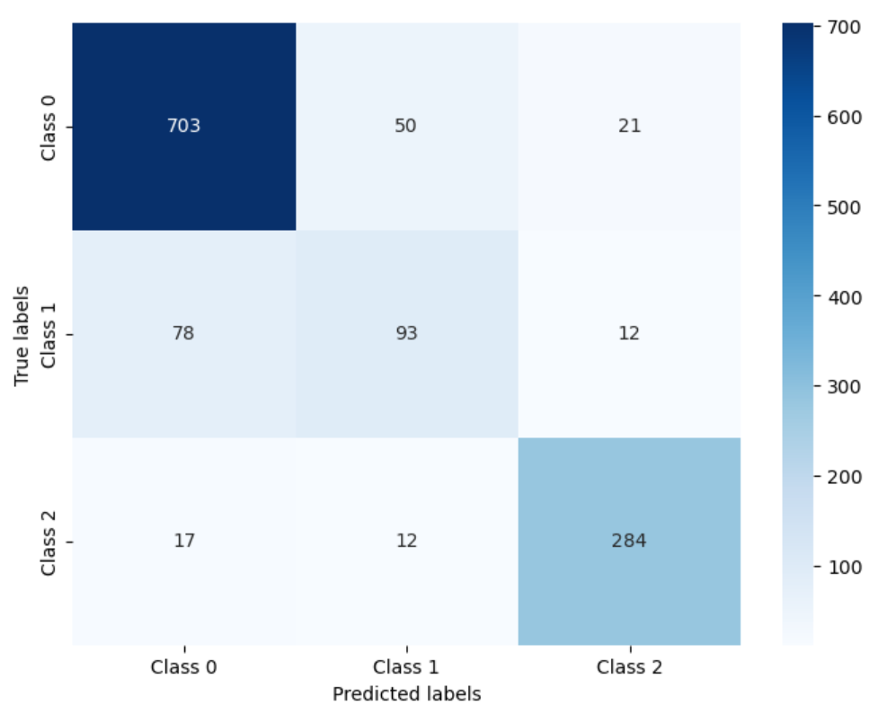
Results
 | Decision Tree | Decision Tree Pruned | Random Forest | Random Forest Pruned | Random Forest Pruned w. 20 best features
Precision | 0.81 | 0.37 | 0.87 | 0.85 | 0.84
Recall | 0.81 | 0.61 | 0.88 | 0.86 | 0.85
F-1 Score | 0.81 | 0.46 | 0.87 | 0.85 | 0.85
Accuracy Score | 0.81 | 0.833 | 0.876 | 0.86 | 0.85
* Explanation and Discussion *
84% of classifications identified as positives were true positives (i.e. precision of 0.84)
Unemployment, GDP per capita, inflation, and sub-national elections (dummy) were some of the features with the highest importance
Final model had lower accuracy (correct prediction %), but was less overfit, and classified “1”s at a better rate. This model is best at classifying “0”s (low uncertainty)
Future research should include additional features (freedom index, governance structure, property rights scores, etc.), more observations, and should have more of a focus on prediction rather than classification alone

